Slide 1
Theory of Computation
Lesson14-2
Approximation Algorithms
王轩
Wang Xuan

Slide 2
Outline
Introduction
MIN-VERTEX-COVER
MAX-CUT
2

Slide 3
Optimization problem
In certain problems called optimization problems we seek to find the best solution among a collection of possible solutions. When an optimization problem is NP-hard, as is the case with the first two of these types of problems, no polynomial time algorithm exit that finds the best solution unless P=NP.
In practice, we may not need the absolute best or optimal solution to a problem. A solution that is nearly optimal may be good enough and may be much easier to find. As its name implies, an approximation algorithm is designed to find such approximately optimal solutions.

Slide 4
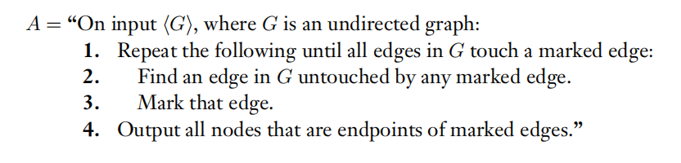
VERTEX-COVER
Question description:
We aim to produce one of the smallest vertex covers among all possible vertex covers in the input graph.

Slide 5
VERTEX-COVER
Theorem 1:
A is a polynomial time algorithm that produces a vertex cover of G that is no more than twice as large as a smallest vertex cover.
Proof:
A obviously runs in polynomial time.
X touches all edges in G. (X be the set of nodes that it outputs)
X <= 2Y
X = 2H
X <= 2Y
H <= Y
H be the set of edges that it marks.

Slide 6
k-optimal
MIN-VERTEX-COVER is an example of a minimization problem because we aim to find the smallest among the collection of possible solutions. In maximization problem we seek the largest solution.
An approximation algorithm for a minimization problem is k-optimal if it always finds a solution that is not more than k times optimal. For a maximization problem a k-optimal approximation algorithm always a solution that is at least 1/k times the size of the optimal.

Slide 7
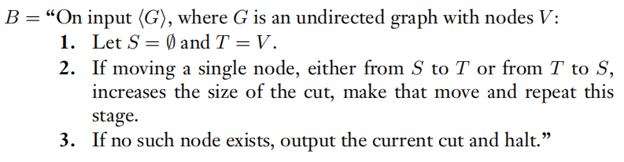
MAX-CUT
Question description:
The MAX-CUT problem ask for a largest cut in the input graph G. (A cut in an approximation algorithm)
The following algorithm approximates MAX-CUT within a factor of 2：

Slide 8
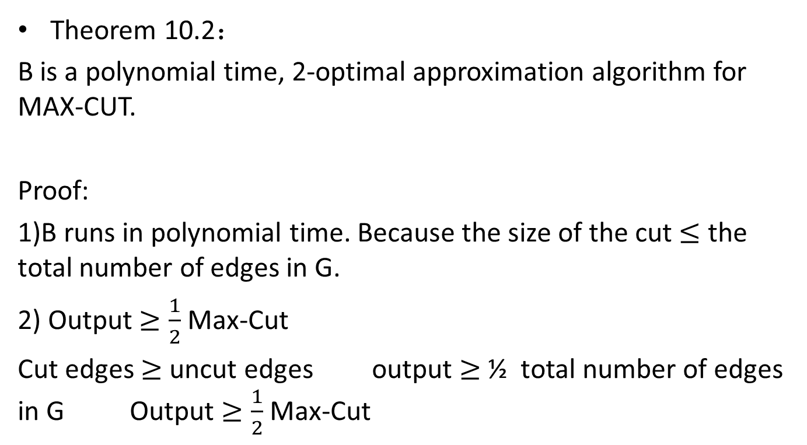
MAX-CUT
Theorem 10.2：
B is a polynomial time, 2-optimal approximation algorithm for MAX-CUT.
Proof:
1)B runs in polynomial time. Because the size of the cut $≤$ the total number of edges in G.
2) Output $≥\frac{1}{2}$Max-Cut
Cut edges $≥$ uncut edges output $≥$ ½ total number of edges in G Output $≥\frac{1}{2}$Max-Cut

Slide 9
Theory of Computation
Lesson14-3
Probabilistic Algorithms
王轩
Wang Xuan

Slide 10
Probabilistic Algorithms
▪A probabilistic algorithm is an algorithm designed to use the outcome of a random process.
▪Typically, such an algorithm would contain an instruction to “flip a coin” and the result of that coin flip would influence the algorithm's subsequent execution and output.
▪Certain types of problems seem to be more easily solvable by probabilistic algorithms than by deterministic algorithms.

Slide 11
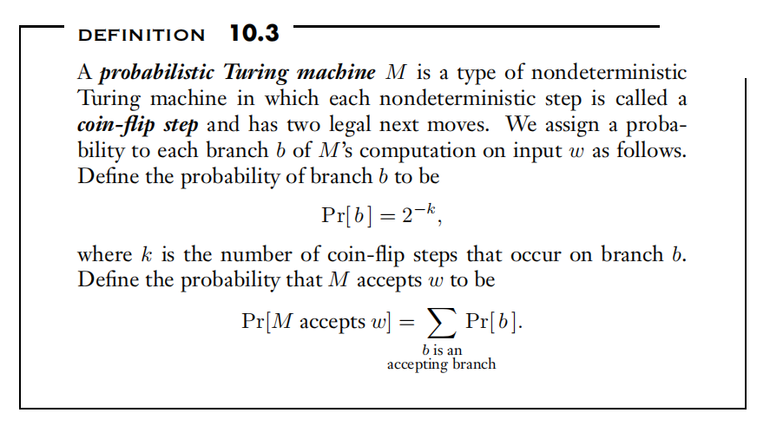
THE CLASS BPP
▪We begin our formal discussion of probabilistic computation by defining a model of a probabilistic Turing machine.

Slide 12


THE CLASS BPP
▪In other words, the probability that M accepts w is the probability that we would reach an accepting configuration if we simulated M on w by flipping a coin to determine which move to follow at each coin-flip step. We let
▪When a probabilistic Turing machine decides a language, it must accept all strings in the language and reject all strings out of the language as usual.
▪Now we allow the machine a small probability of error.
For 0 ≤ ε < 1/2 , we say that M decides language A with error probability ε if

Slide 13
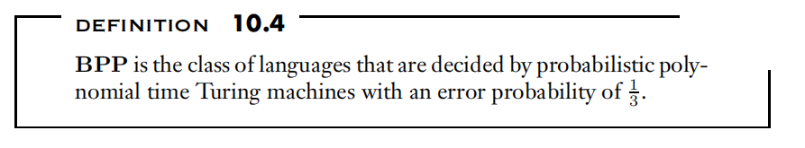
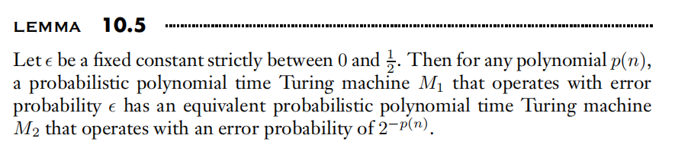
Primality
▪We measure the time and space complexity of a probabilistic Turing machine in the same way we do for a nondeterministic Turing machine: by using the worst case computation branch on each input.

Slide 14
Proof
▪PROOF IDEA
M2 simulates M1 by running it a polynomial number of times and taking the majority vote of the outcomes. The probability of error decreases exponentially with the number of runs of M1 made.
Consider the case where ε = 1/3.
It corresponds to a box that contains many red and blue balls. We know that 2/3 of the balls are of one color and that the remaining 1/3 are of the other color, but we don't know which color is predominant.
We can test for that color by sampling several—say, 100—balls at random to determine which color comes up most frequently.
the predominant color in the box the most frequent one in the sample

Slide 15
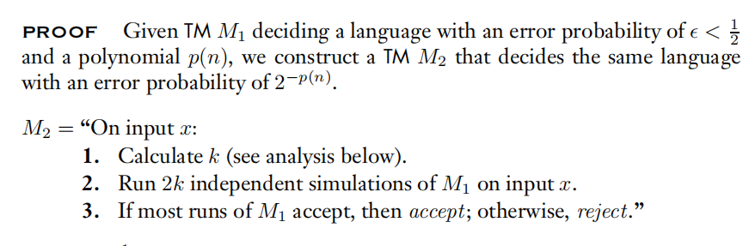
Proof
▪PROOF IDEA
balls branches of M1’s computation
accepting
rejecting
M2 samples the color by running M1.
A calculation shows that M2 errs with exponentially small probability if it runs M1 a polynomial number of times and outputs the result that comes up most often.

